Slide 1
Using Regular Expressions in Java
COP 4020

Slide 2
Outline
Creating a Sample Test Program
Java Highlights
Example Scenario

Slide 3
Creating a Sample Test Program
Focus on what you want to understand
REs in code, specifically Java
Allow for mutability
Modify the text to examine
(re)-Compile different REs
Menu
Print state
Print results

Slide 4
Java Highlights
import java.util.regex.Pattern;
import java.util.regex.Matcher;
// ...
String re = new String( "\\d" );
String some_tokens[];
Pattern pattern = Pattern.compile(re);
// ...
pattern = Pattern.compile(re);
// ...
Matcher match = pattern.matcher(text);
// ...
match.find()
System.out.println( "Matching String: " + match.group() );
System.out.println( "Starting Index: " + match.start() );
System.out.println( "Ending Index: " + match.end() );
// ...
some_tokens = pattern.split(text);

Slide 5
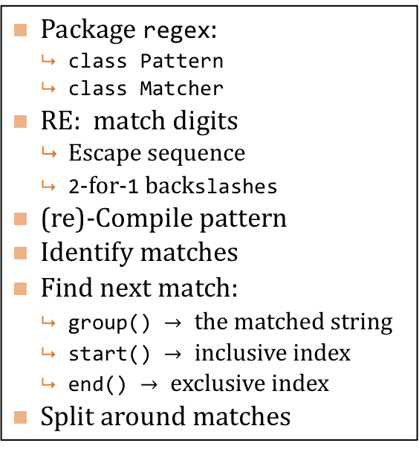
Java Highlights
import java.util.regex.Pattern;
import java.util.regex.Matcher;
// ...
String re = new String( "\\d" );
String some_tokens[];
Pattern pattern = Pattern.compile(re);
// ...
pattern = Pattern.compile(re);
// ...
Matcher match = pattern.matcher(text);
// ...
match.find()
System.out.println( "Matching String: " + match.group() );
System.out.println( "Starting Index: " + match.start() );
System.out.println( "Ending Index: " + match.end() );
// ...
some_tokens = pattern.split(text);
Package regex:
class Pattern
class Matcher
RE: match digits
Escape sequence
2-for-1 backslashes
(re)-Compile pattern
Identify matches
Find next match:
group() $→$ the matched string
start() $→$ inclusive index
end() $→$ exclusive index
Split around matches

Slide 6
Sample Text to Examine
Lyrics: "...They say two-thousand-zero-zero party over\n\tOops out of time\n\tSo tonight I'm gonna party like it's 1999...”
Telephone Numbers
"111-222-3333, 222-333-4444, 333 444 5555, 555.666.7777, (666) 777-8888, (777) 888.9999"
HTML
"<html><title>example</title><body>the body of the example</body></html>"

Slide 7
Sample REs
What is matched by these REs? Try them out!
<.*?>
<[^/].+?>
</.+?>
(\([0-9]{3}\)|[0-9]{3})[ -][0-9]{3}[ -][0-9]{4}

Slide 8
Sample REs
Using the telephone numbers and REs already provided, as well as these additional valid and invalid numbers, what would be the grammar for our telephone numbers?
Valid
888 999-0000
Invalid
(999) 0000000
(000)111-2222

